Slide 1
SECURE DATA HIDING IN IMAGES USING STEGANOGRAPHY
CAPSTONE PROJECT
Presented By: Priyadarshiny Das
Student Name : Priyadarshiny Das
College Name & Department : Techno Main Salt Lake, Computer Science And Engineering- Cyber Security (Department of Information Technology)

Slide 2
OUTLINE
Problem Statement
Technology used
Wow factor
End users
Result
Conclusion
Git-hub Link
Future scope

Slide 3
Problem Statement
In today’s world, safeguarding personal information online has become increasingly important. Sensitive information of individuals and organizations, such as financial information and trade secrets, must be protected at all costs from unauthorised access. When such information is transferred or transmitted online, there are chances of the network or transmission lines being infiltrated by hackers. If the information being transferred is not encrypted properly and entirely, then it can be used to cause reputational damage and immense financial losses, and for threatening and blackmailing. In such cases, image steganography (encrypting information within images) can prove to be extremely useful, as it can secure the sensitive information in such a manner that it becomes almost impossible to decipher, without making any humanly-visible changes in the image. In this project, image steganography has been implemented through a Python program to encrypt the message within the image. This message is password-protected and will be displayed only on entering the correct password.

Slide 4
Technology used
LIBRARIES USED:
OpenCV (cv2)
String
os
PLATFORMS USED:
Python 3.13.2

Slide 5
Wow factors
Simple algorithms.
Secure method of encrypting data.
Low time complexity and fast execution.
Difference between the original and the new images is unnoticeable.

Slide 6
End users
Educational Institutions
Business Institutions
Intelligence Agencies
Military and Defence Organizations
Certified Ethical Hackers
Organizations or individuals related to Law Enforcement
Steganography can also be used by the general public for communication purposes for added privacy and protection.

Slide 7
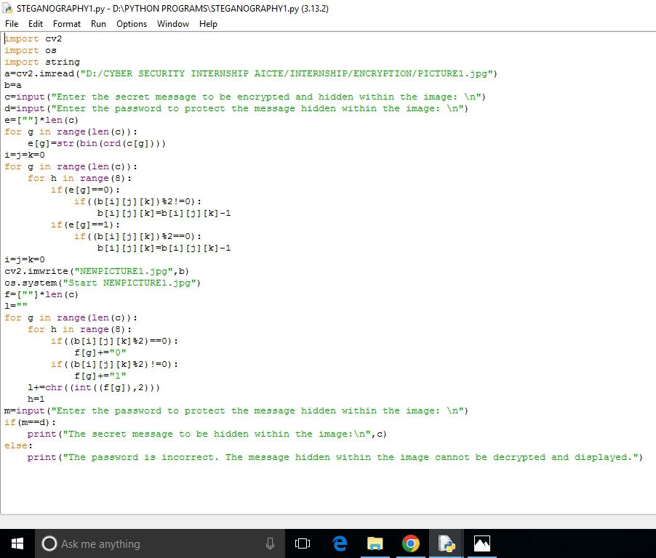

Results
ORIGINAL IMAGE

Slide 8
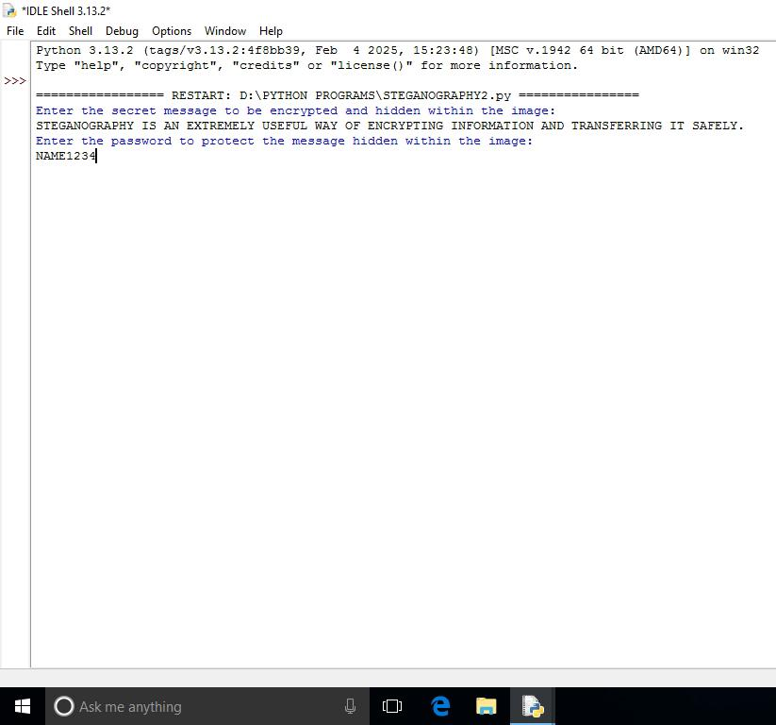

Results
NEW IMAGE

Slide 9
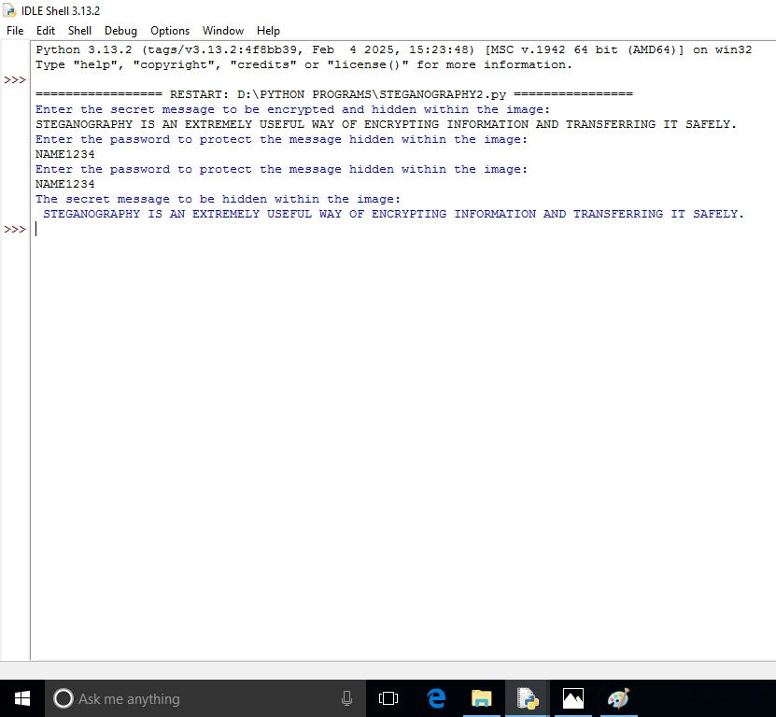

Results
NEW IMAGE

Slide 10
Conclusion
In this project, steganography has been implemented in a simple manner using the Least Significant Bit method. Steganography is a powerful method of communicating sensitive information in a secure manner. It can be used to hide information without raising suspicion, since there are no significant changes in the looks of the image used. The method used to implement steganography in this project can be used in real life for small-scale purposes between individuals for exchanging private information with added security, as the information is password protected.

Slide 11
GitHub Link
https://github.com/AICTE-INTERNSHIP-STEGANOGRAPHY/PROJECT.git

Slide 12
THANK YOU

